Slide 1

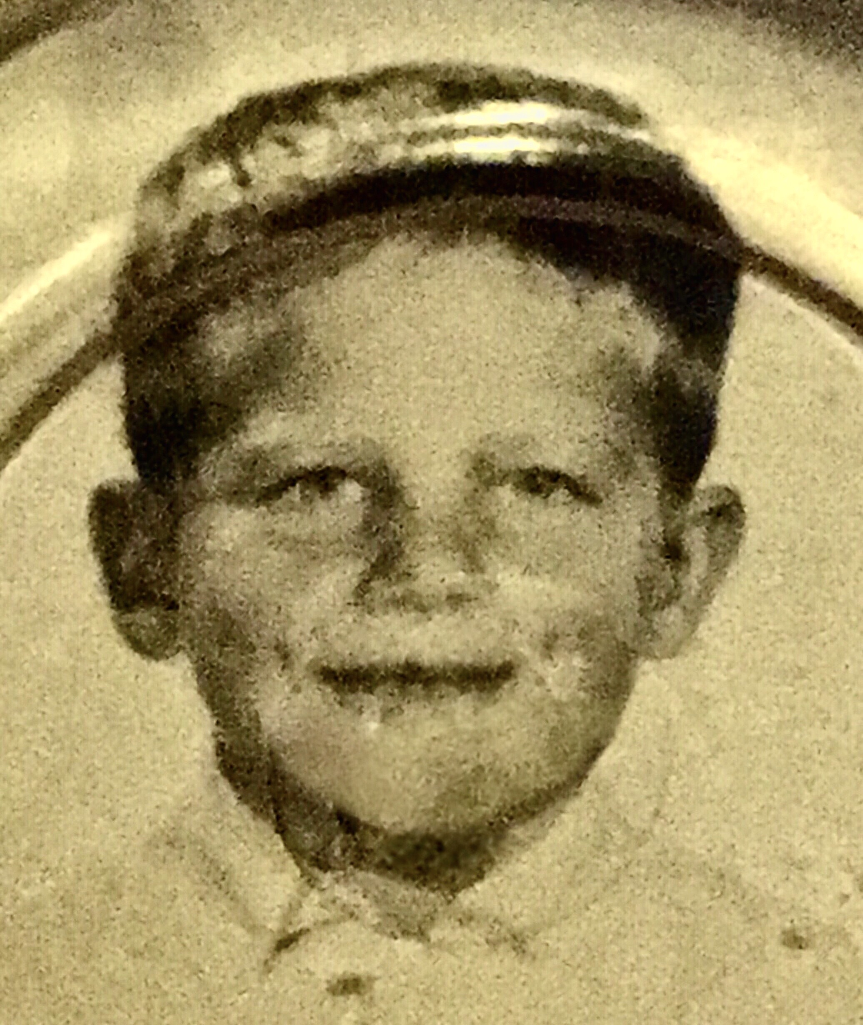
Welcome to my class!
My name is Tony Del Vecchio,
and I will be your teacher this term!
(Me at five years old)

Slide 2
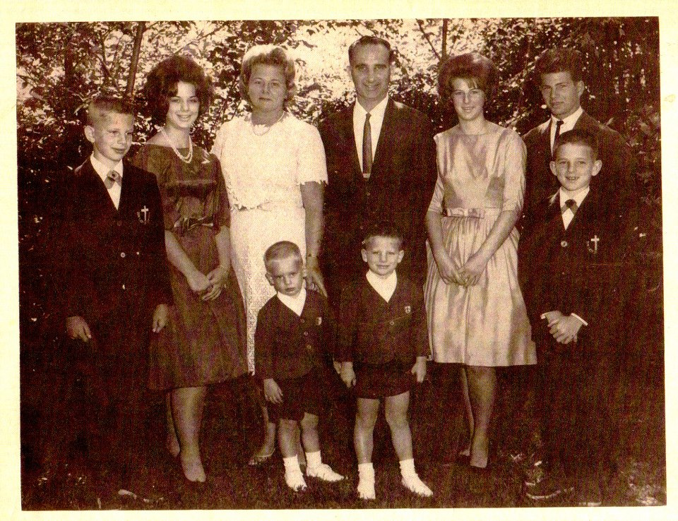
I come from a small town
called Springfield, New Jersey,
in the U.S.A. When I was a kid,
my Dad was the Mayor, so
everybody in town knew us.
And yes, we had a big family!

Slide 3
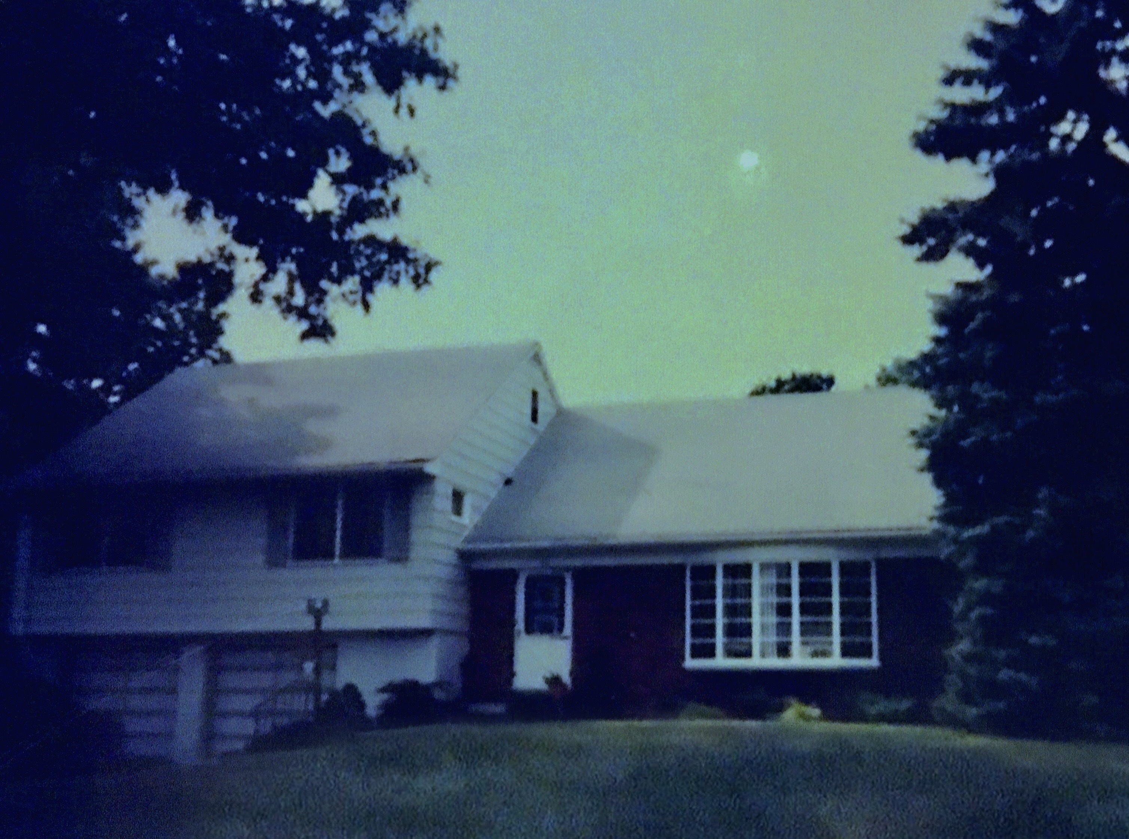
We lived in a four-bedroom house in the suburbs that my
Uncle George (an architect) and my Dad (an engineer) designed and built.

Slide 4
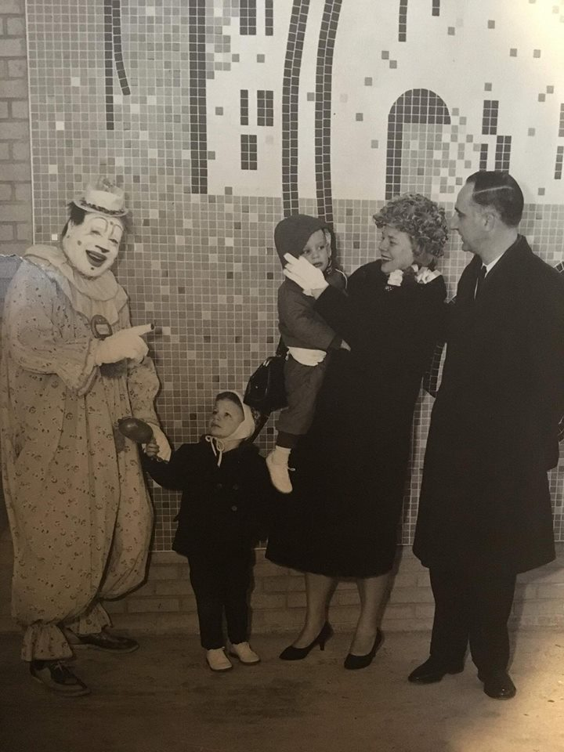
Here, my Dad the Mayor is officially
opening a new supermarket in town.
(My brother David was
scared of clowns! LOL)

Slide 5
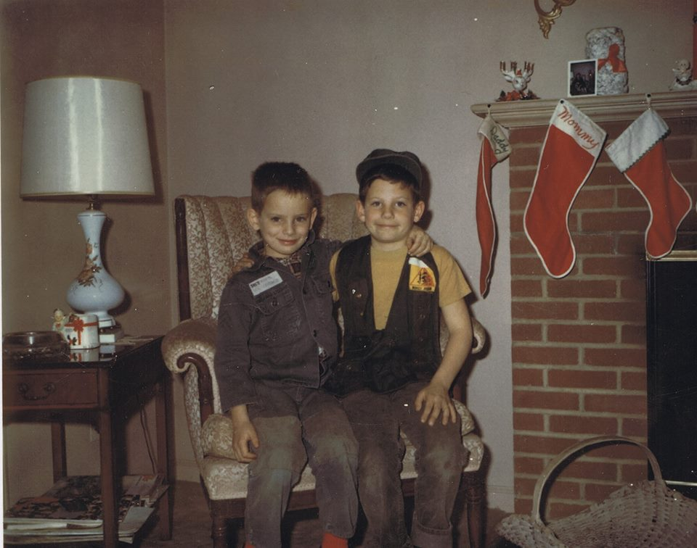
David and I were best
buddies growing up.

Slide 6
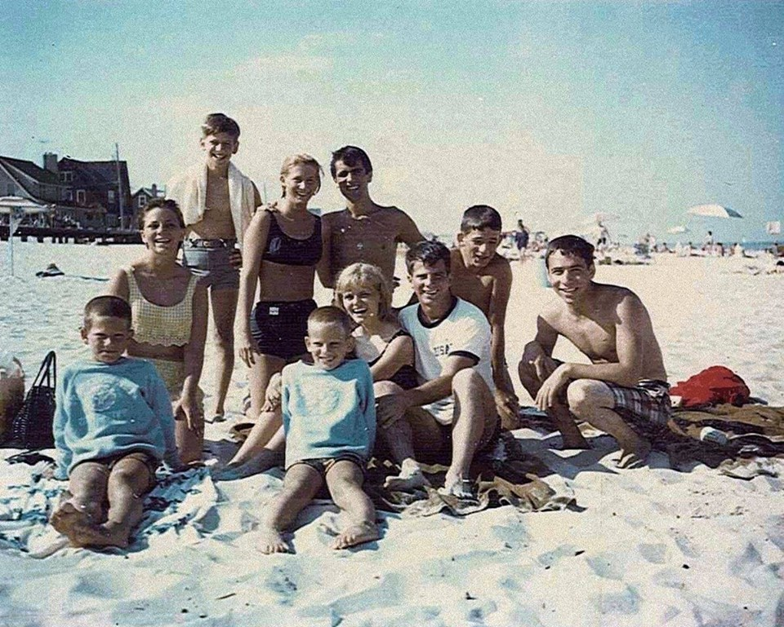
Every summer, we would
go “down the Shore” and enjoy
a month swimming and playing
at the beach in Lavalette.
We had a great time there!

Slide 7
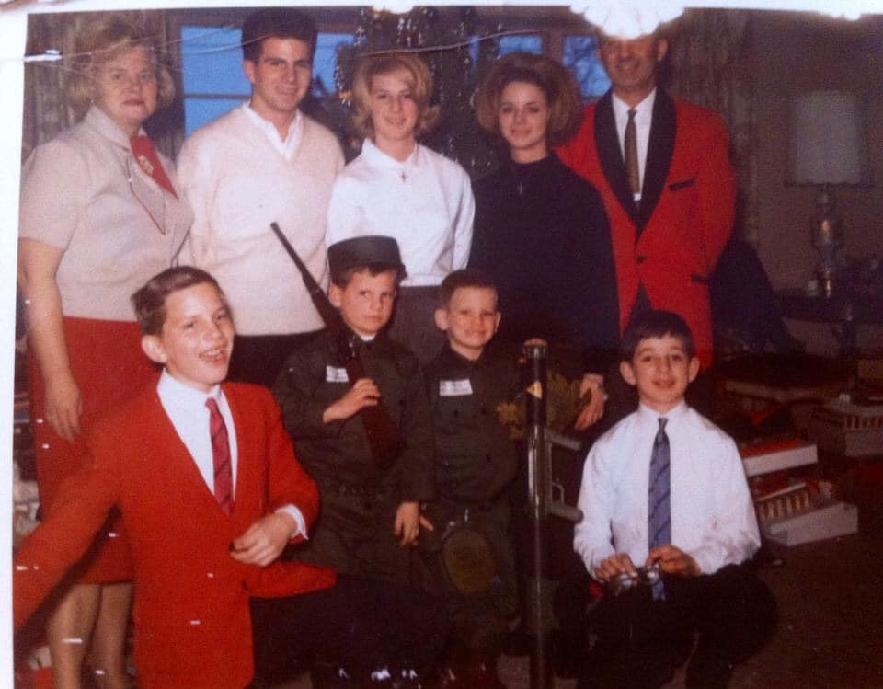
Christmas was always a fun
time at the Del Vecchio house.
(Here I am trying to look
like a tough army guy!)

Slide 8
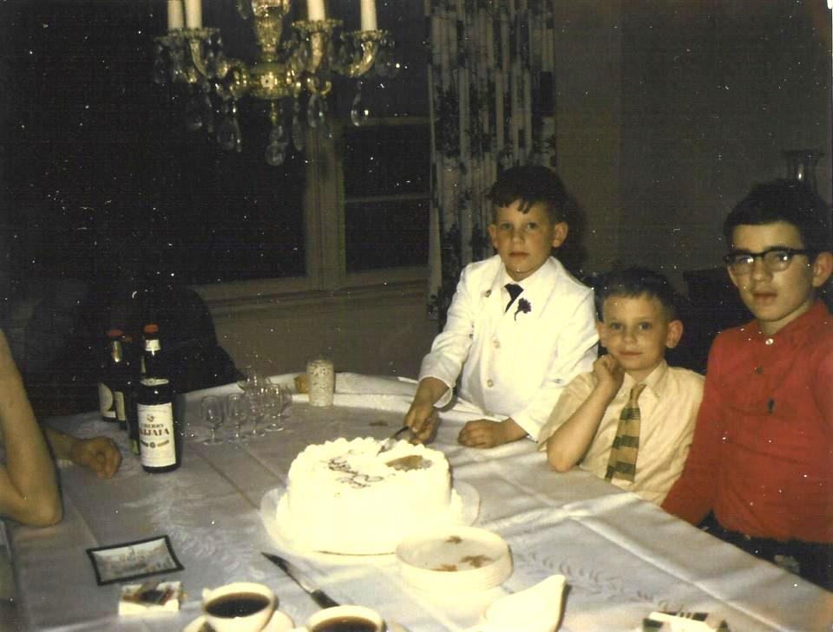
I went to Catholic elementary
school. Here I am celebrating
my First Holy Communion.
(with brothers Dave and Paul)

Slide 9
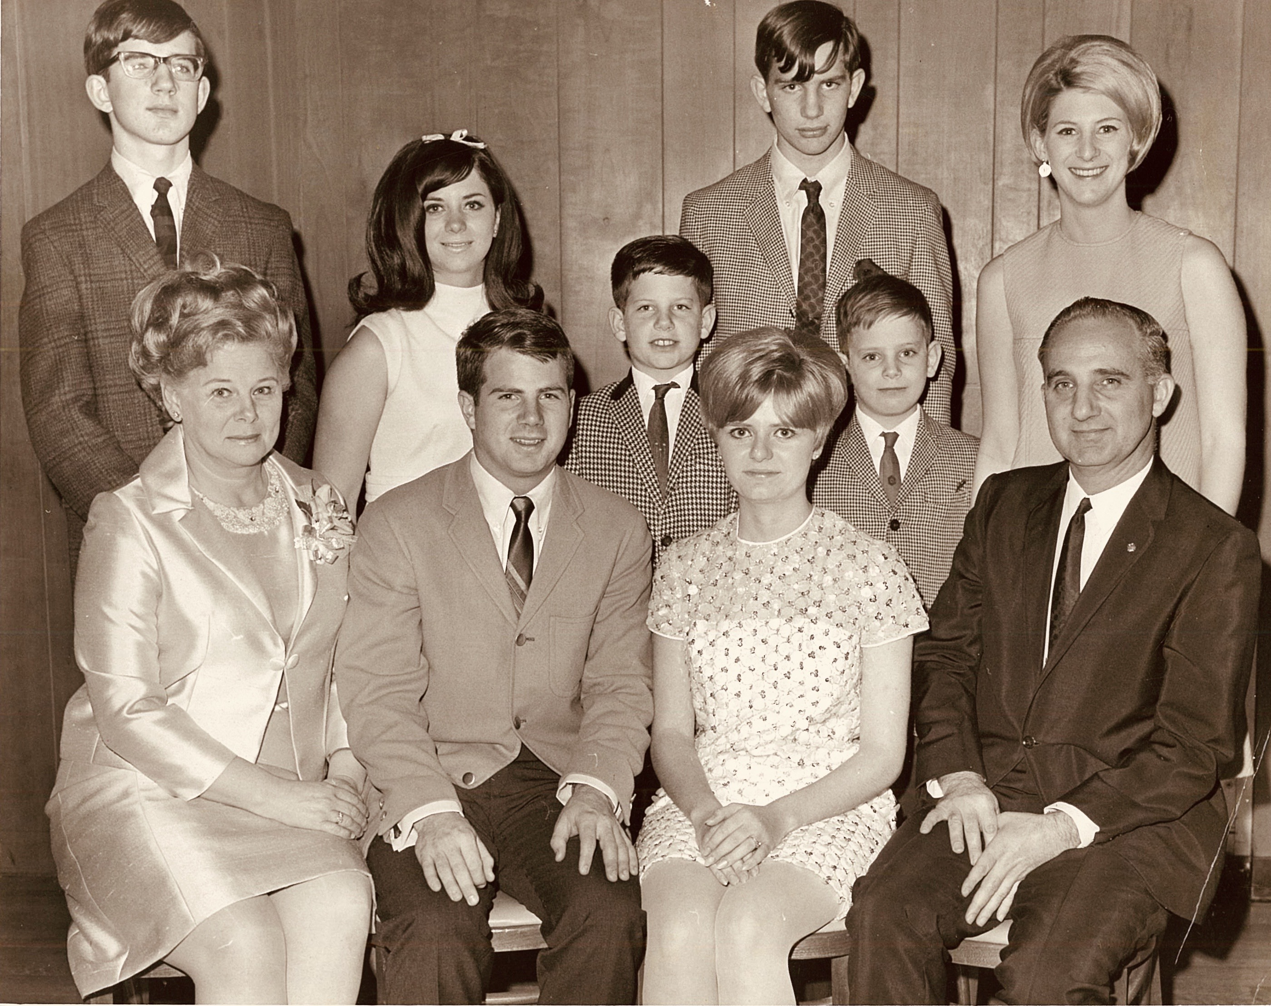
Eleven years old. Family pic at my
brother Phil’s engagement party.

Slide 10
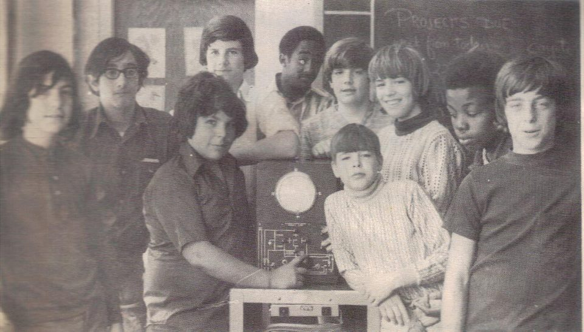
I later went to public
junior high school, so
I experienced a
little of both worlds —
private and public schools.
(That’s me in the back.)

Slide 11
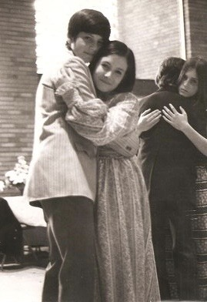
It was in junior high school where I first fell
in love. That’s me and my girlfriend Janie
dancing at her Bat Mitzvah (sort of a
Jewish Coming-of-Age ceremony).

Slide 12
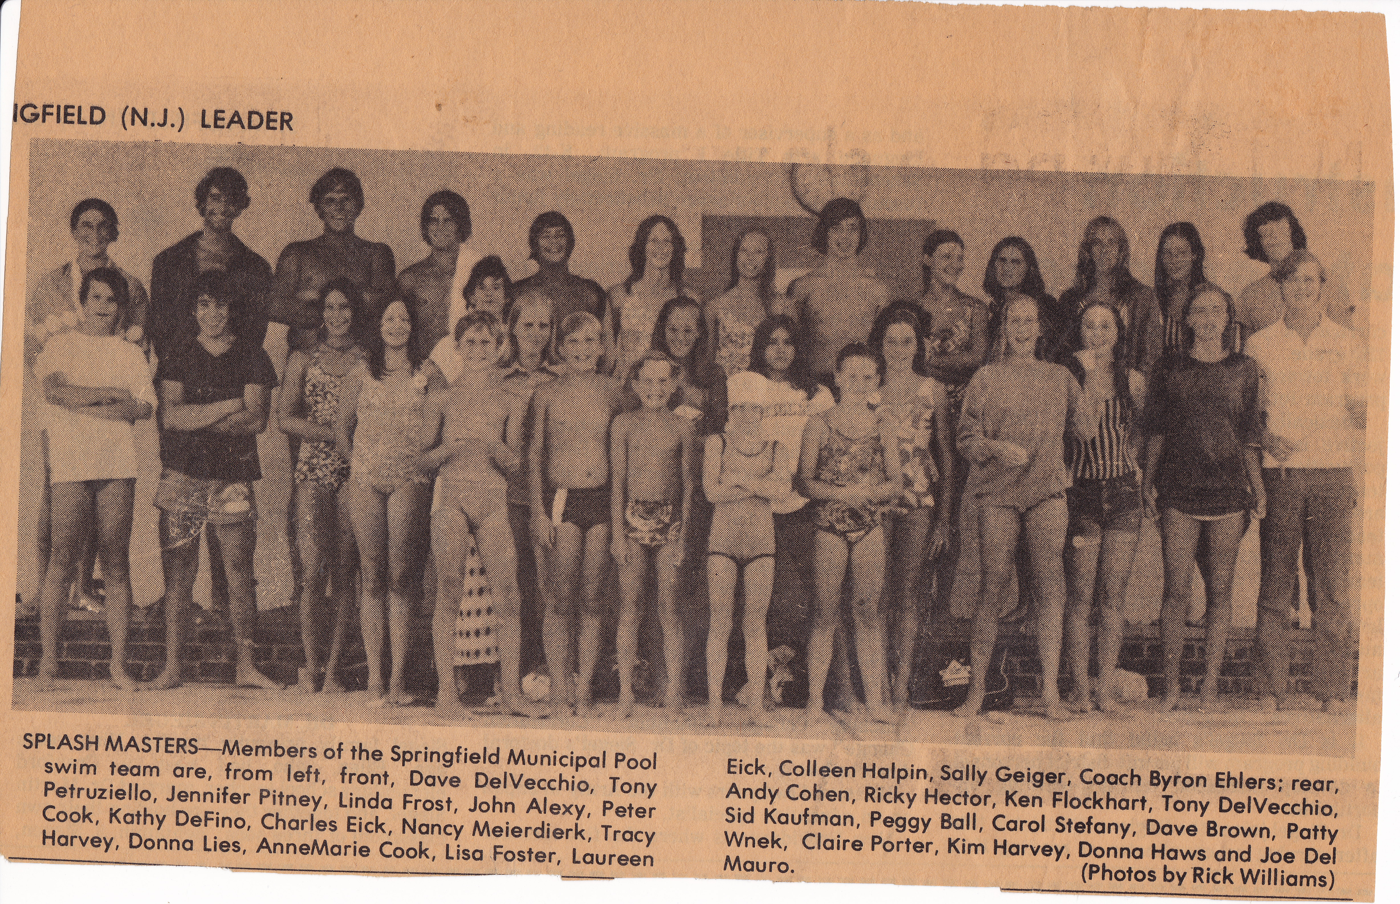
As a kid, I was on the local swim team. (back row, 4th from the left)

Slide 13
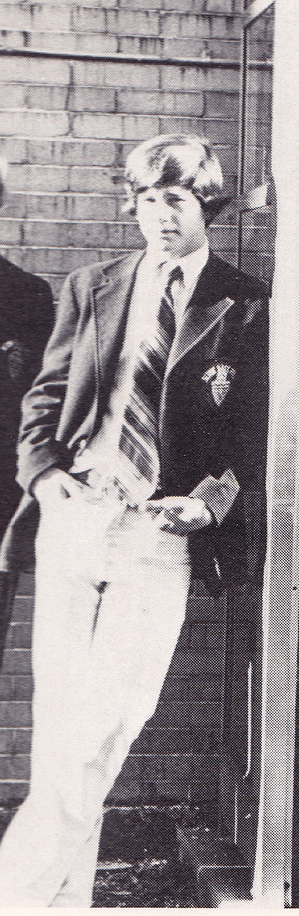
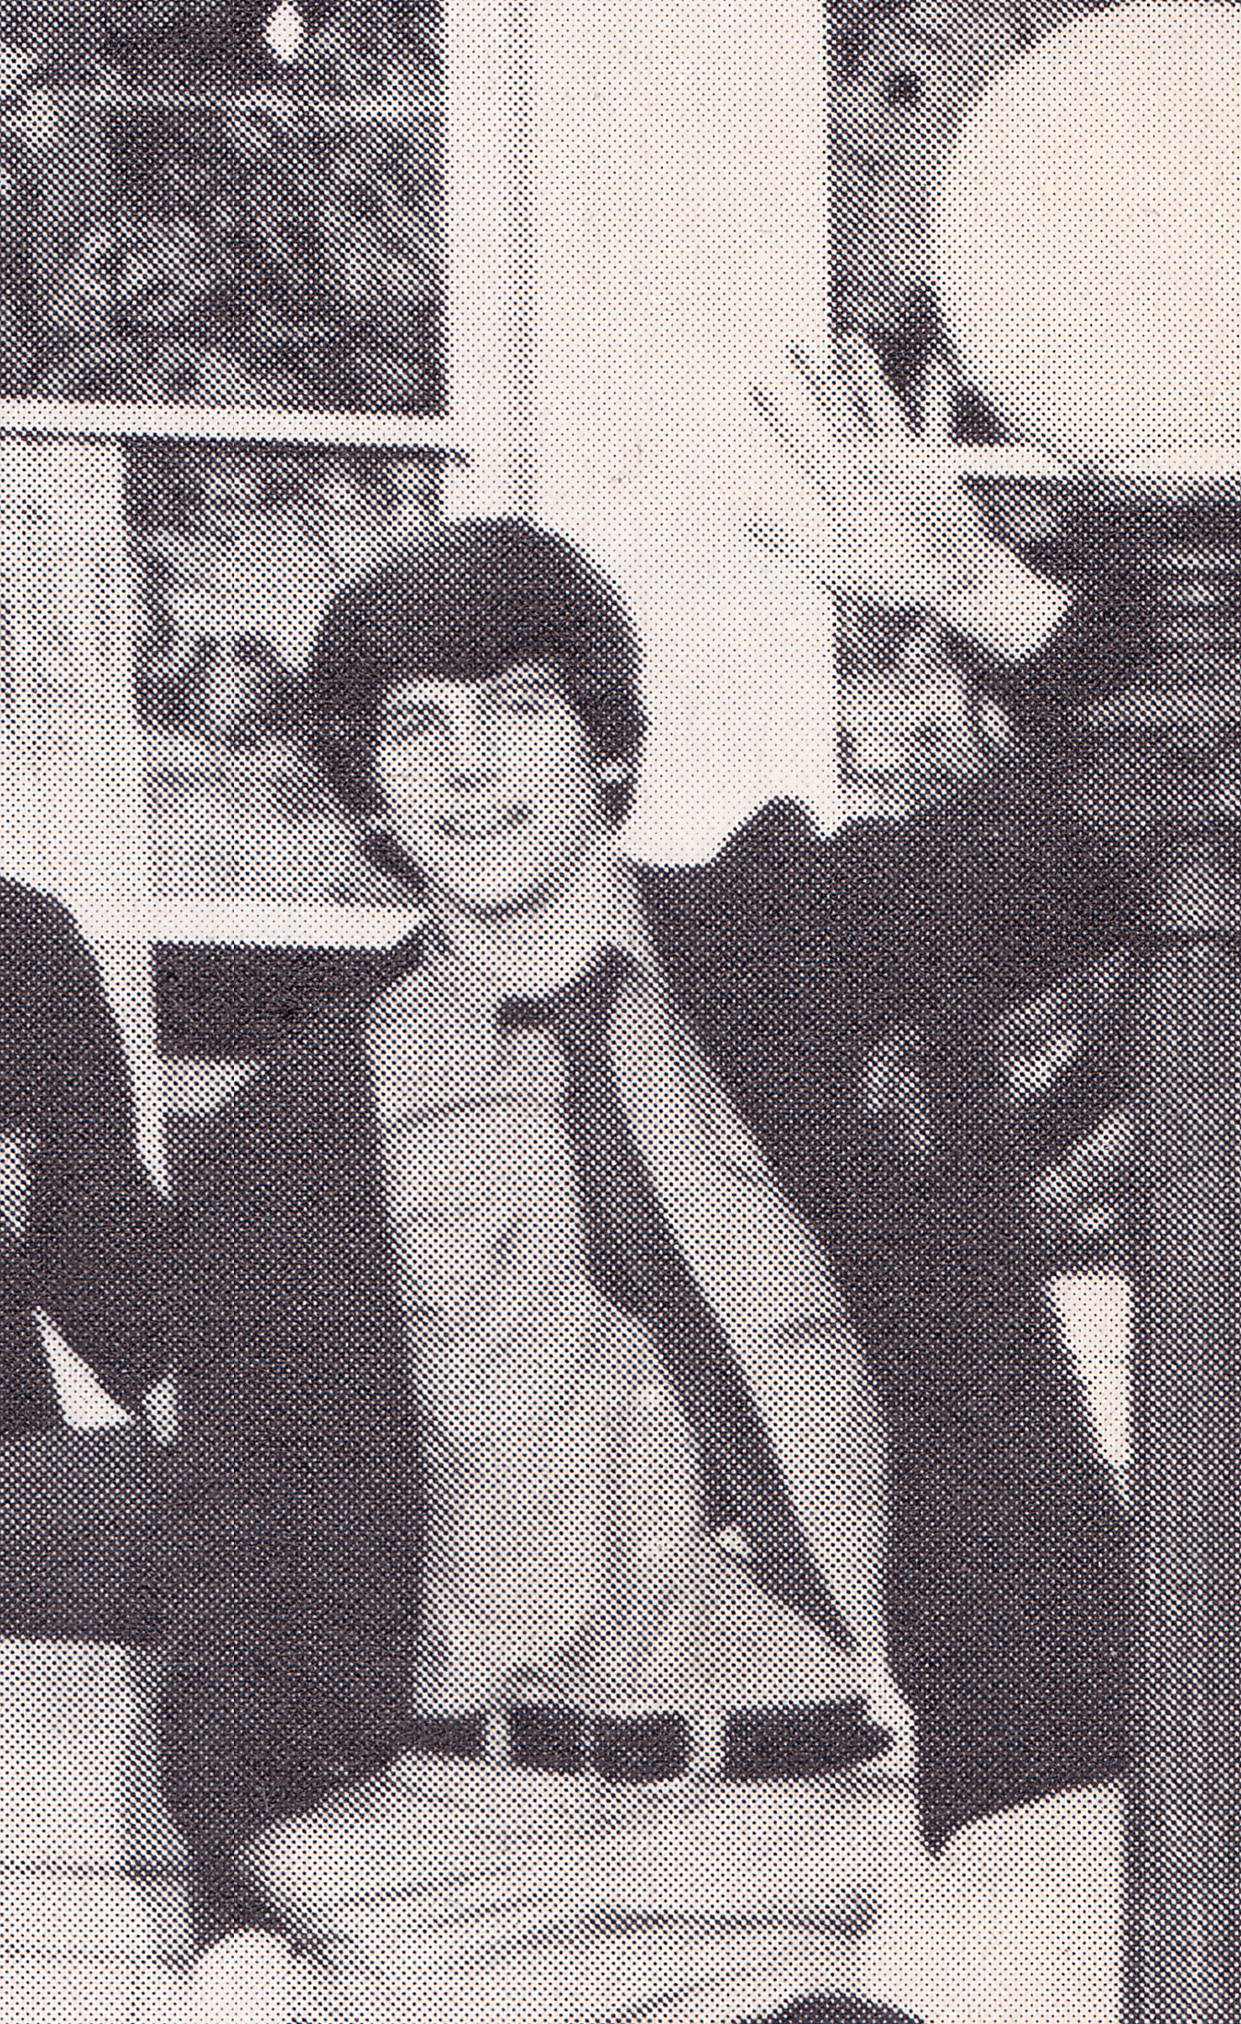
After junior high school,
I attended a Catholic
prep school.
<—- Freshman year
Sophomore Year —->

Slide 14
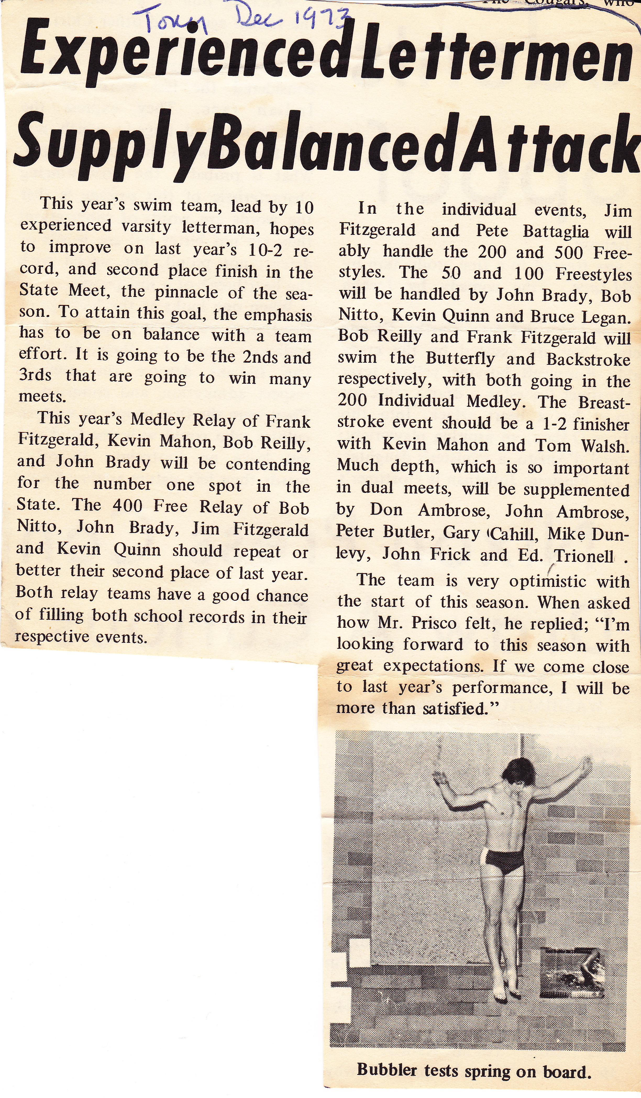
I was on the Swimming and
Diving Team there as well.

Slide 15
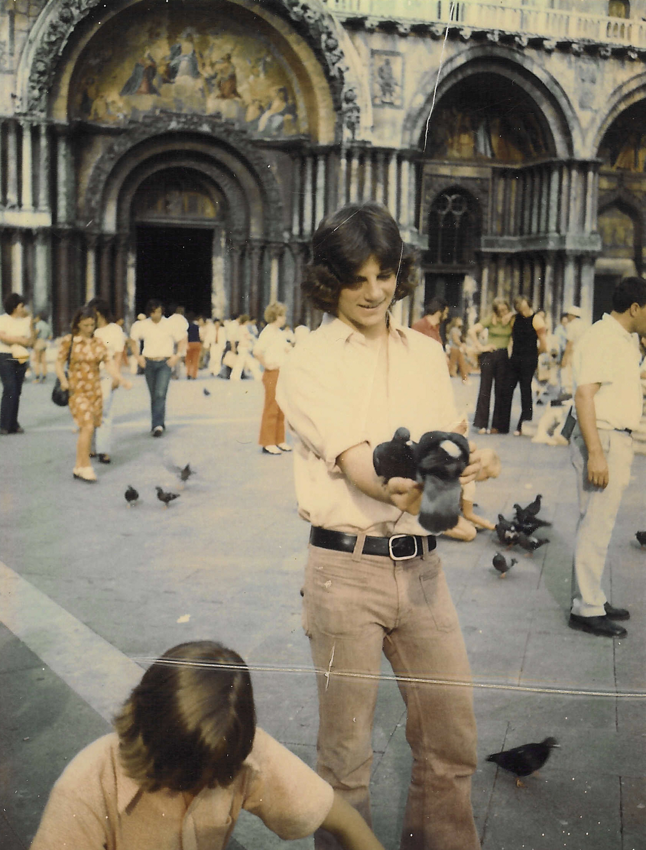
One of my favorite memories from
my high school days was going to
Europe with my parents. I especially
loved Italy. Here I am with David
in St. Mark’s Square in Venice feeding
some pigeons. They were everywhere!

Slide 16
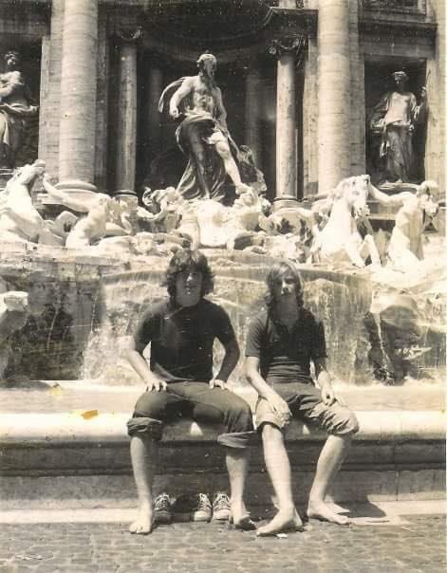
Keeping cool at the
Trevi Fountain in Rome.

Slide 17
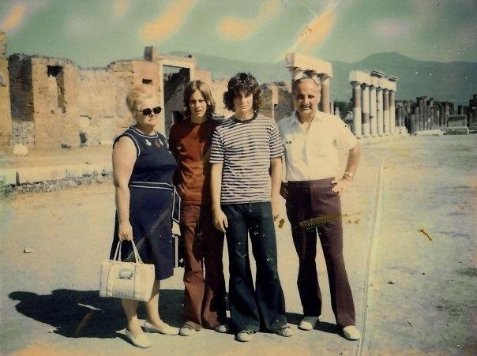
And with the folks at the
ancient city of Pomeii.
I loved this place. I’ve
always been interested in
history and archeology.

Slide 18
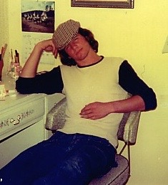
Hanging out at another
girlfriend’s house. I got into
all kinds of trouble back
then. Ah, to be 16 again!

Slide 19
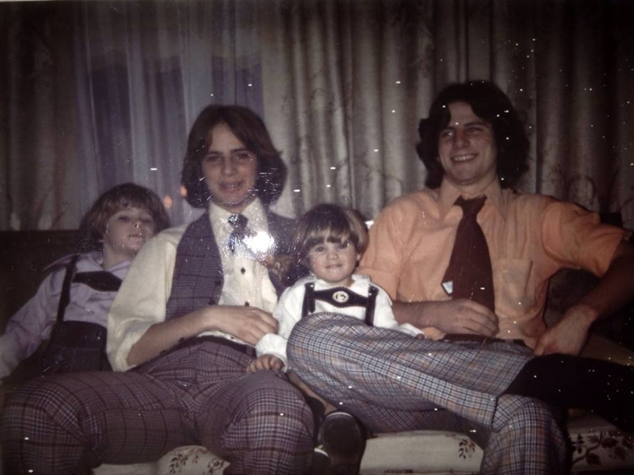
All that hair!
And those
pants! The
style in 1974.

Slide 20
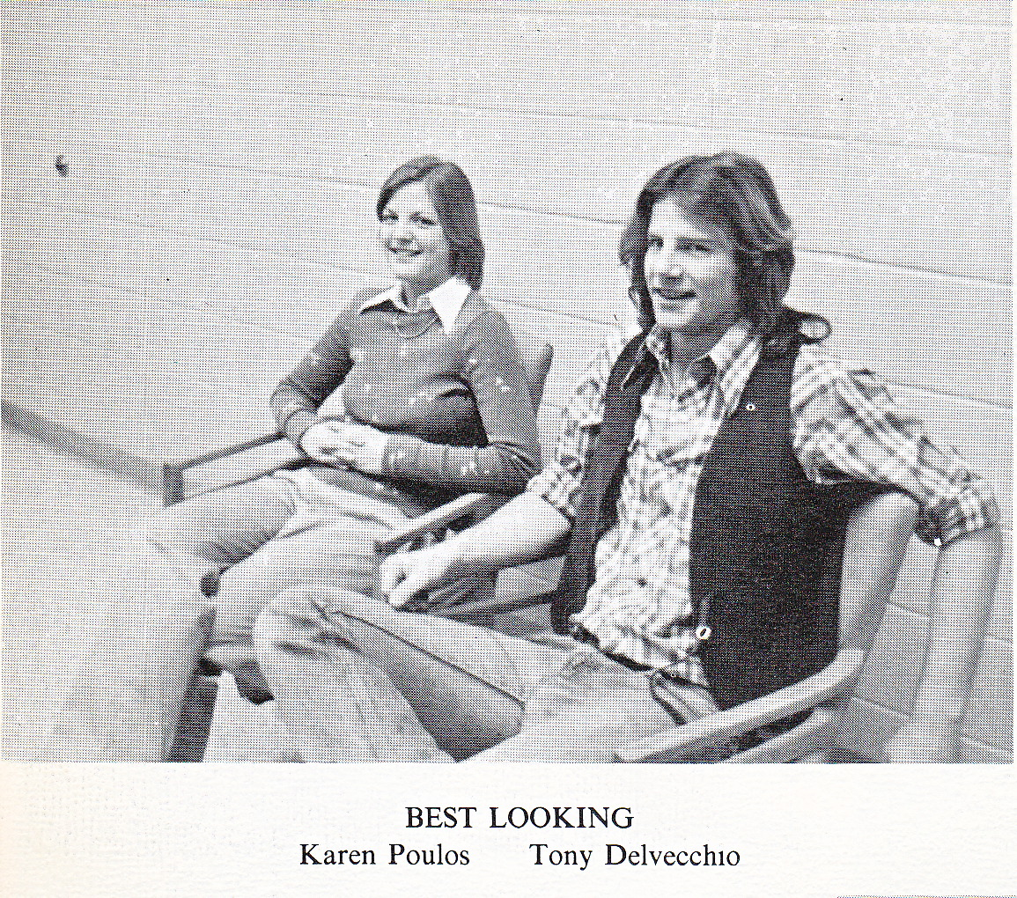
I wound up spending my
fourth year of high school
at the public school in town.
I really enjoyed the freedom
there. The girls there voted me
Best Looking in the senior
class. I guess I can see that. LOL

Slide 21
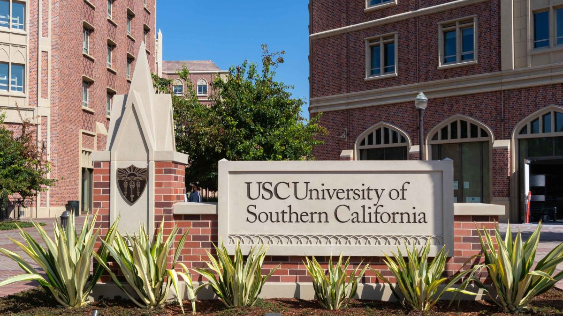
After high school I left New Jersey and
attended college at USC in Los Angeles.
Living in California gave me a
little introduction to “culture shock”!

Slide 22
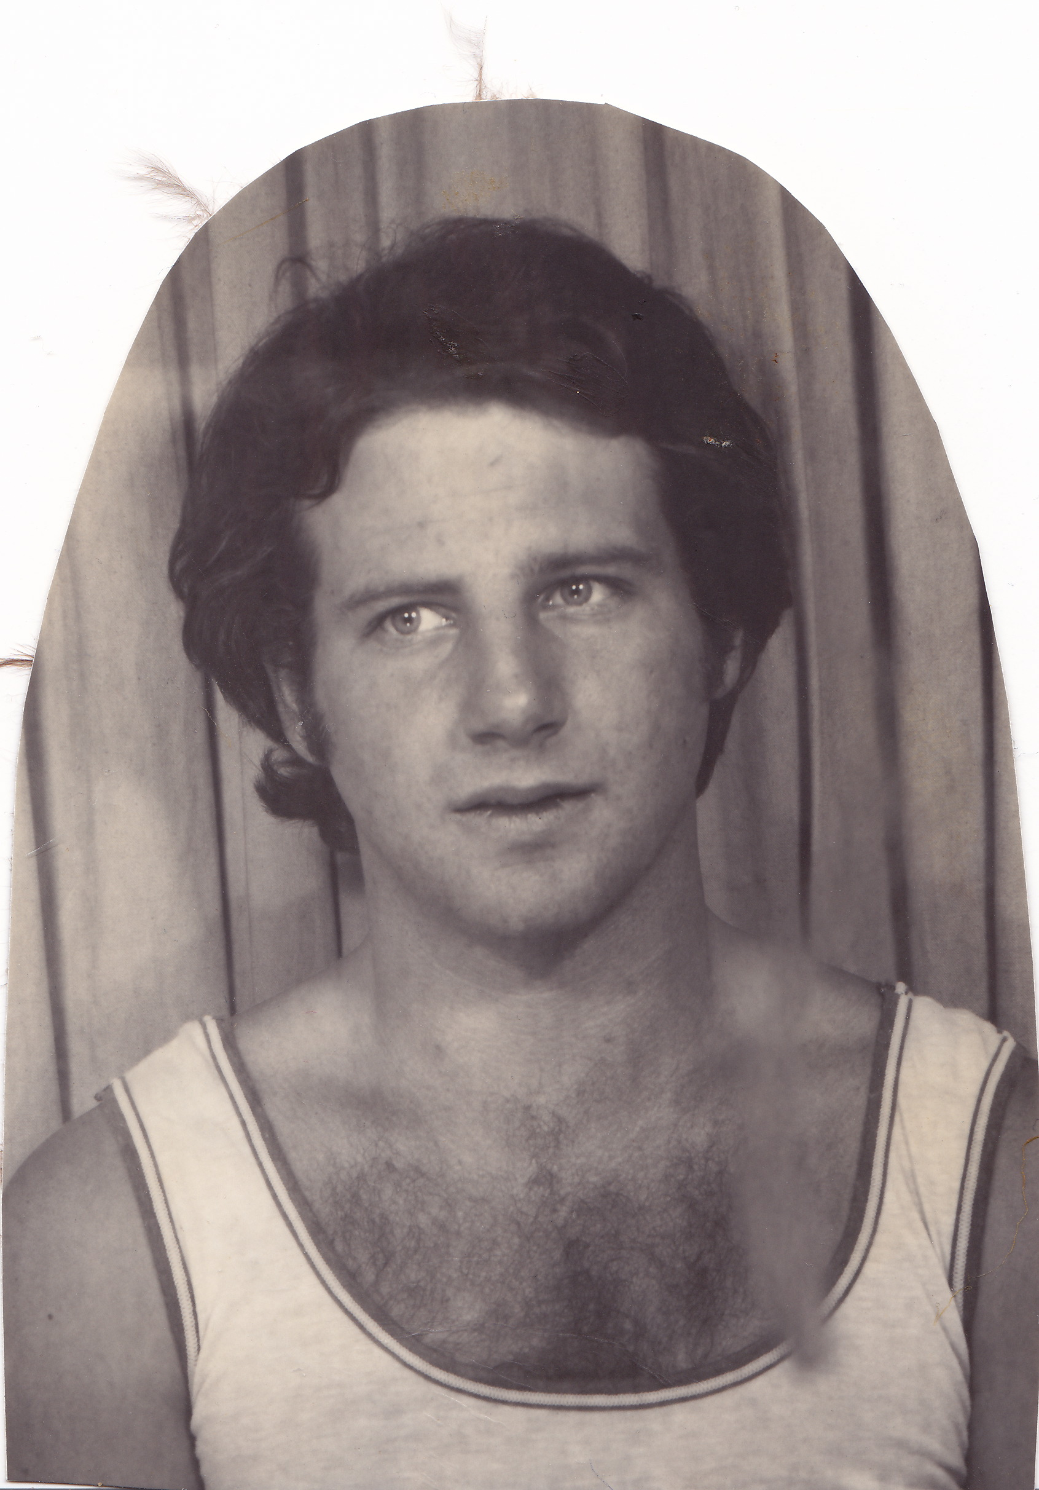
That’s me at 21 years old
getting my picture taken at
a photo booth in Venice Beach.

Slide 23
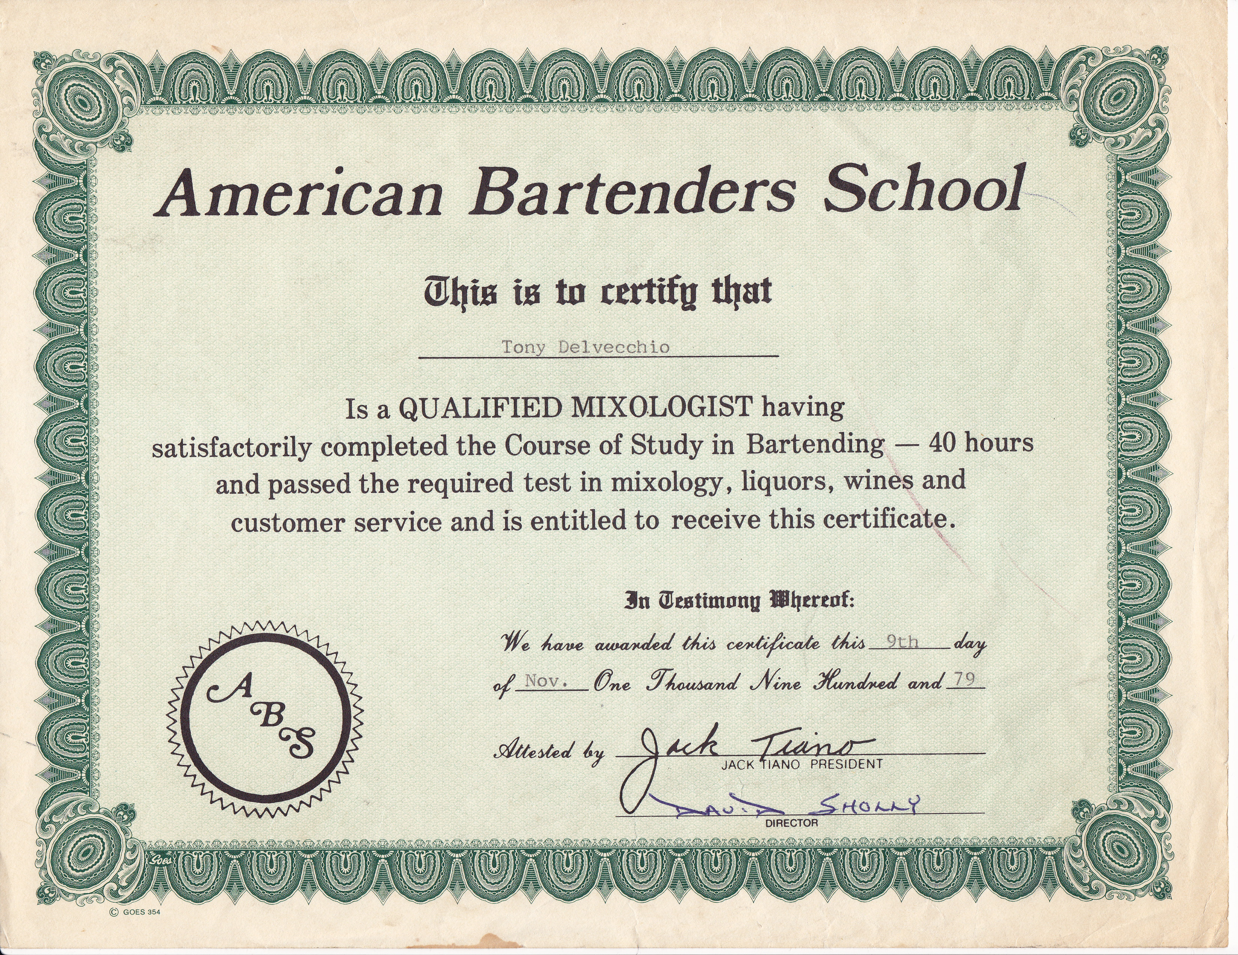
I needed to support myself in college, so I laid out $400 for a two-week course
at the American Bartenders School and became a “Qualified Mixologist”. LOL

Slide 24
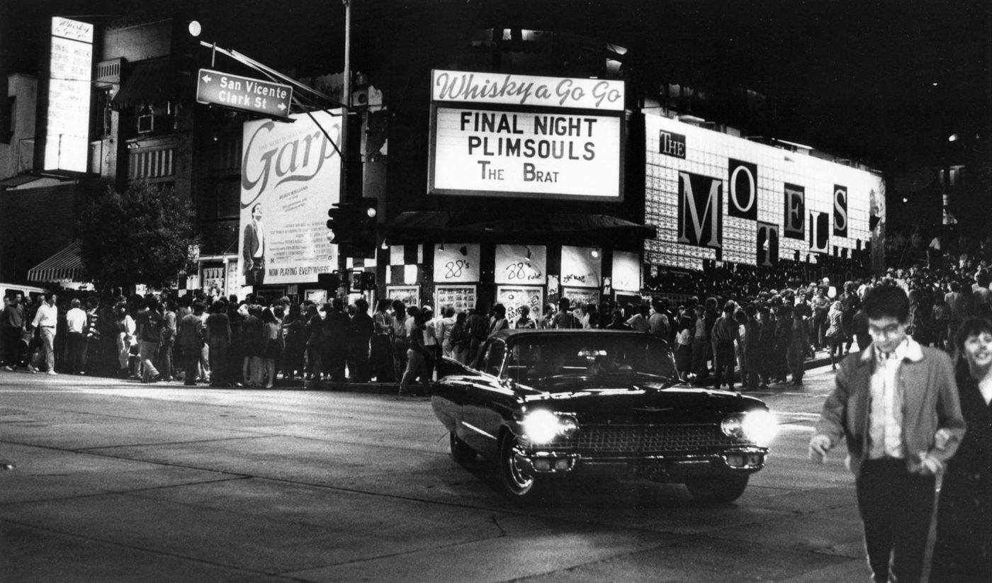
It turned out to be a good investment. Using my newly acquired knowledge, I hit up a bunch of
bars and clubs in LA looking for a job, lying about my experience. I managed to get a job at the world famous Whisky a Go Go, the premier punk rock club in town on the Sunset Strip in Hollywood.
(The manger, Ray, happened to be a USC alumni and I guess wanted to “help a brother out.”)

Slide 25
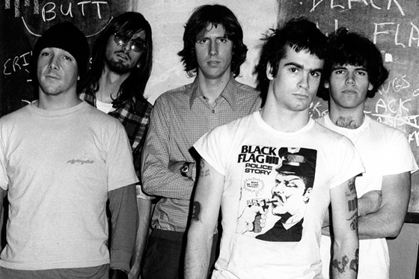
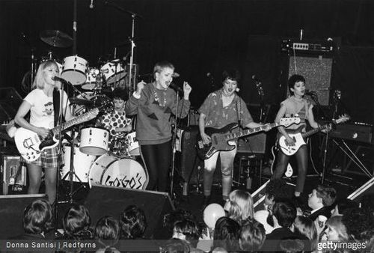
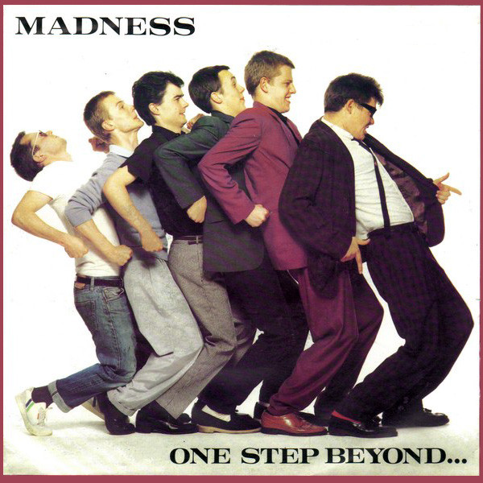
I got to see lots of great
punk bands for free
while I was working
there, like Black Flag,
The Go-Gos, and Madness.
It was 1980 and the
height of the LA punk
scene, so I was really
lucky to land the gig!

Slide 26
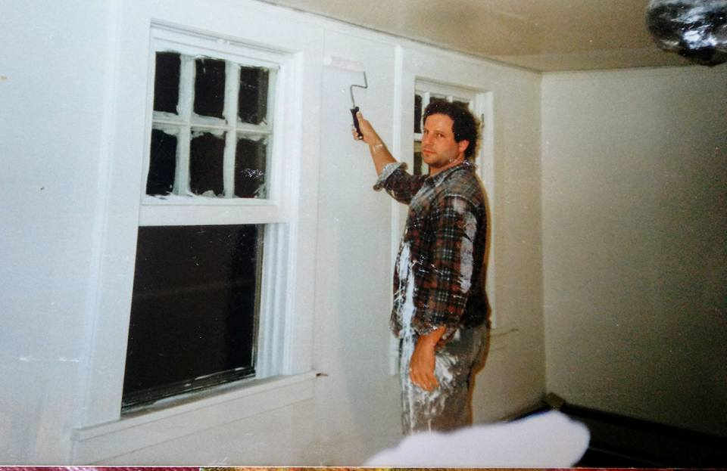
After university,
I moved back to
New Jersey and got
a job working in an
insurance company.
Here I am painting my
apartment in Millburn.
I think I got more paint
on me than I got on
the walls. Ha Ha

Slide 27
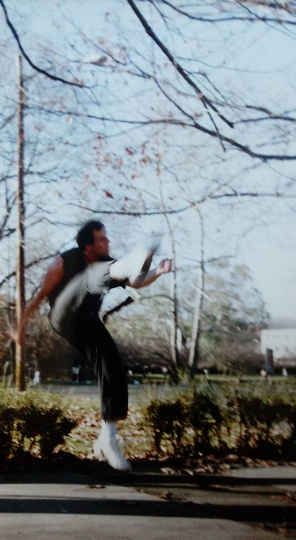
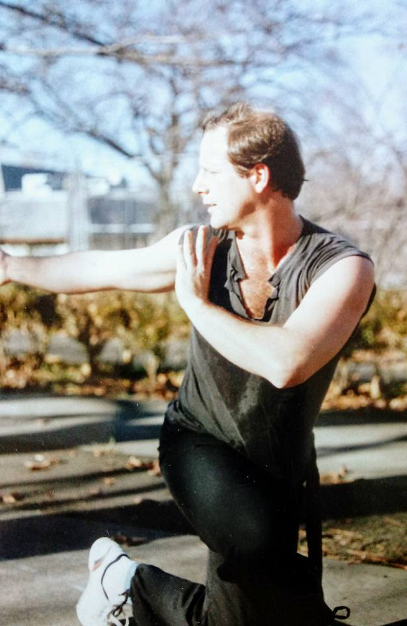
I took up some new
hobbies, including
Tae Kwon Do
and Shaolin Gung Fu

Slide 28
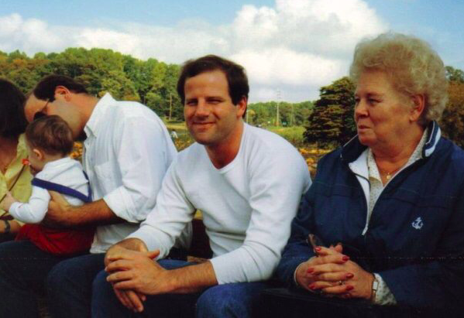
Went pumpkin hunting
in the fall with the family.
With David, my nephew
Mike, and Mom. 1987

Slide 29
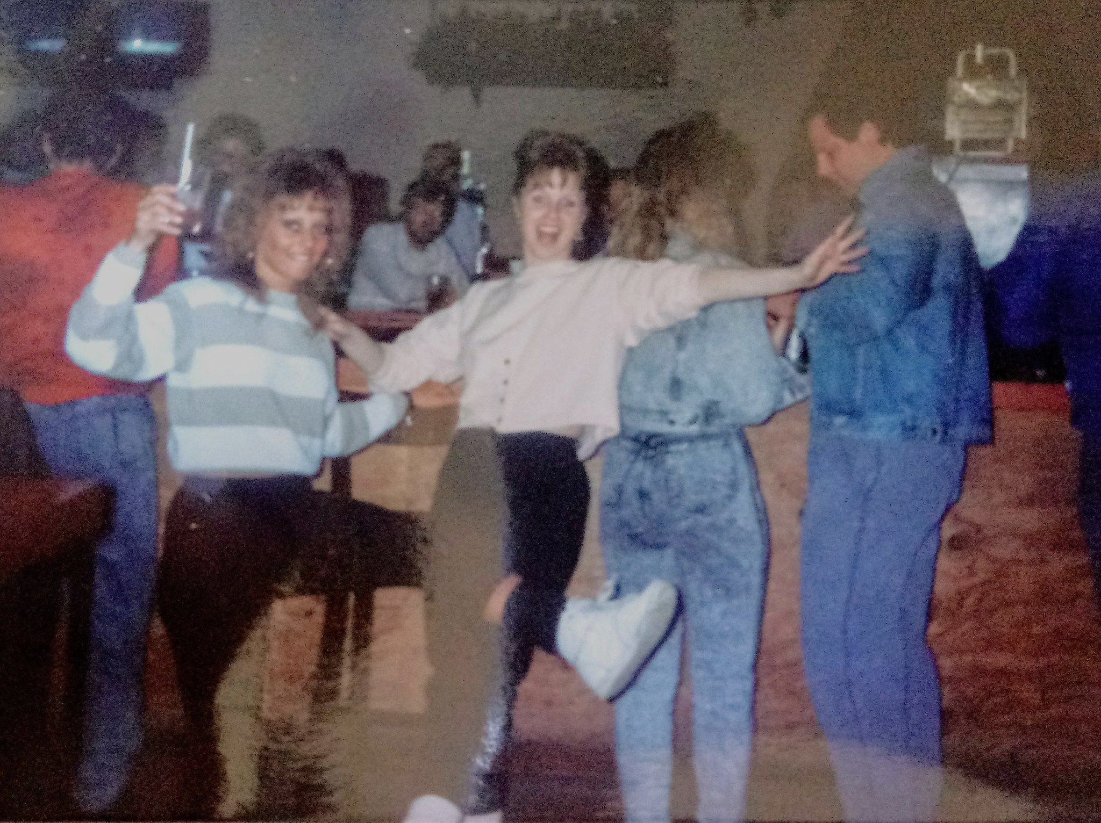
Out drinking
with friends.
1988

Slide 30
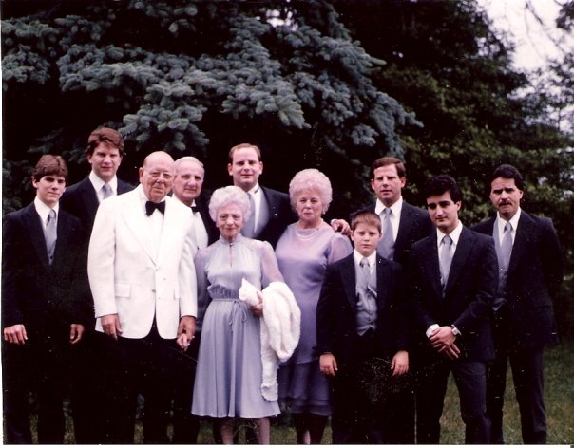
David’s
wedding.

Slide 31
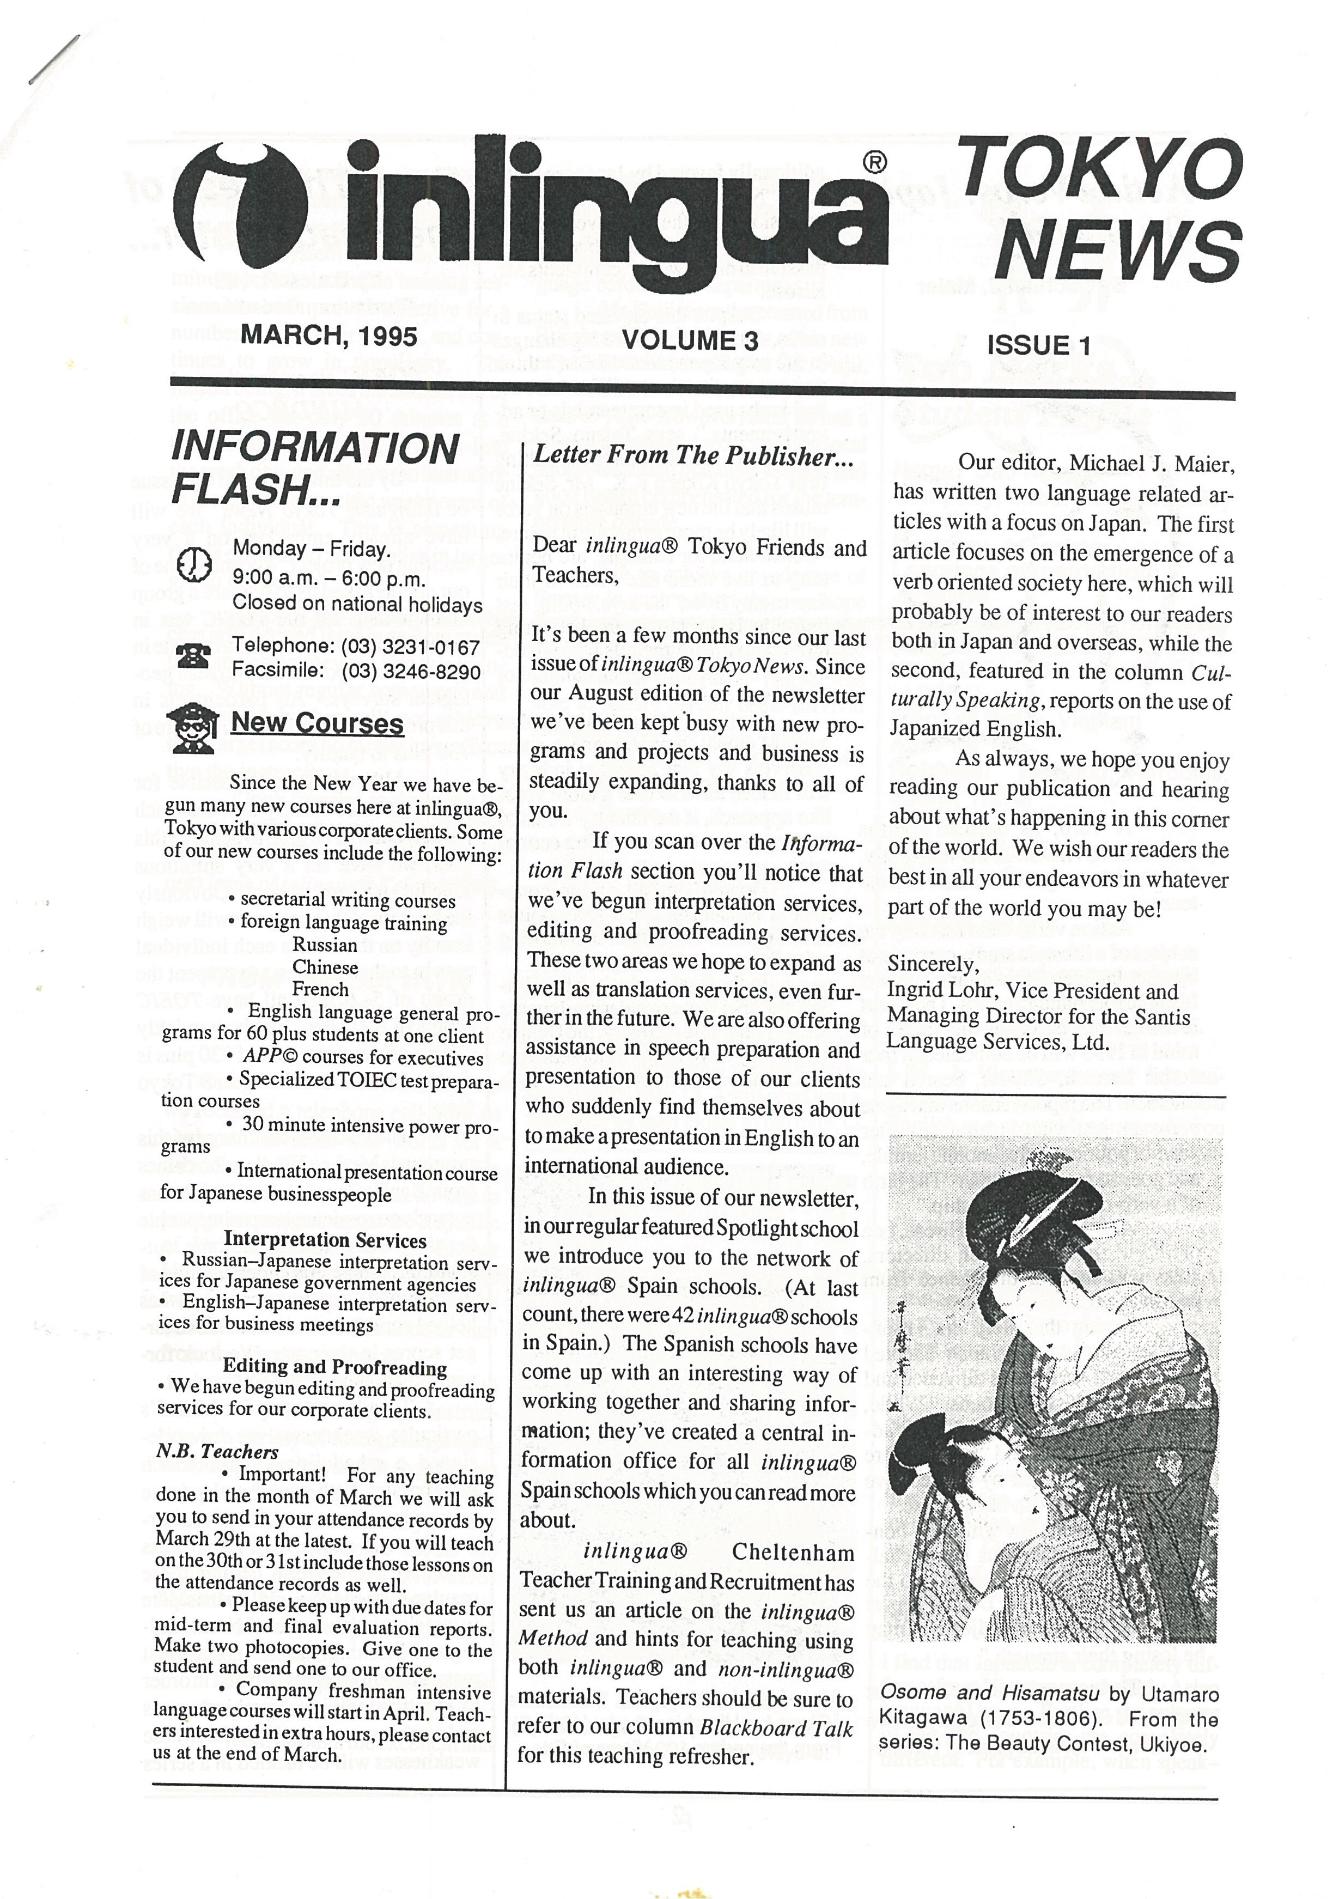
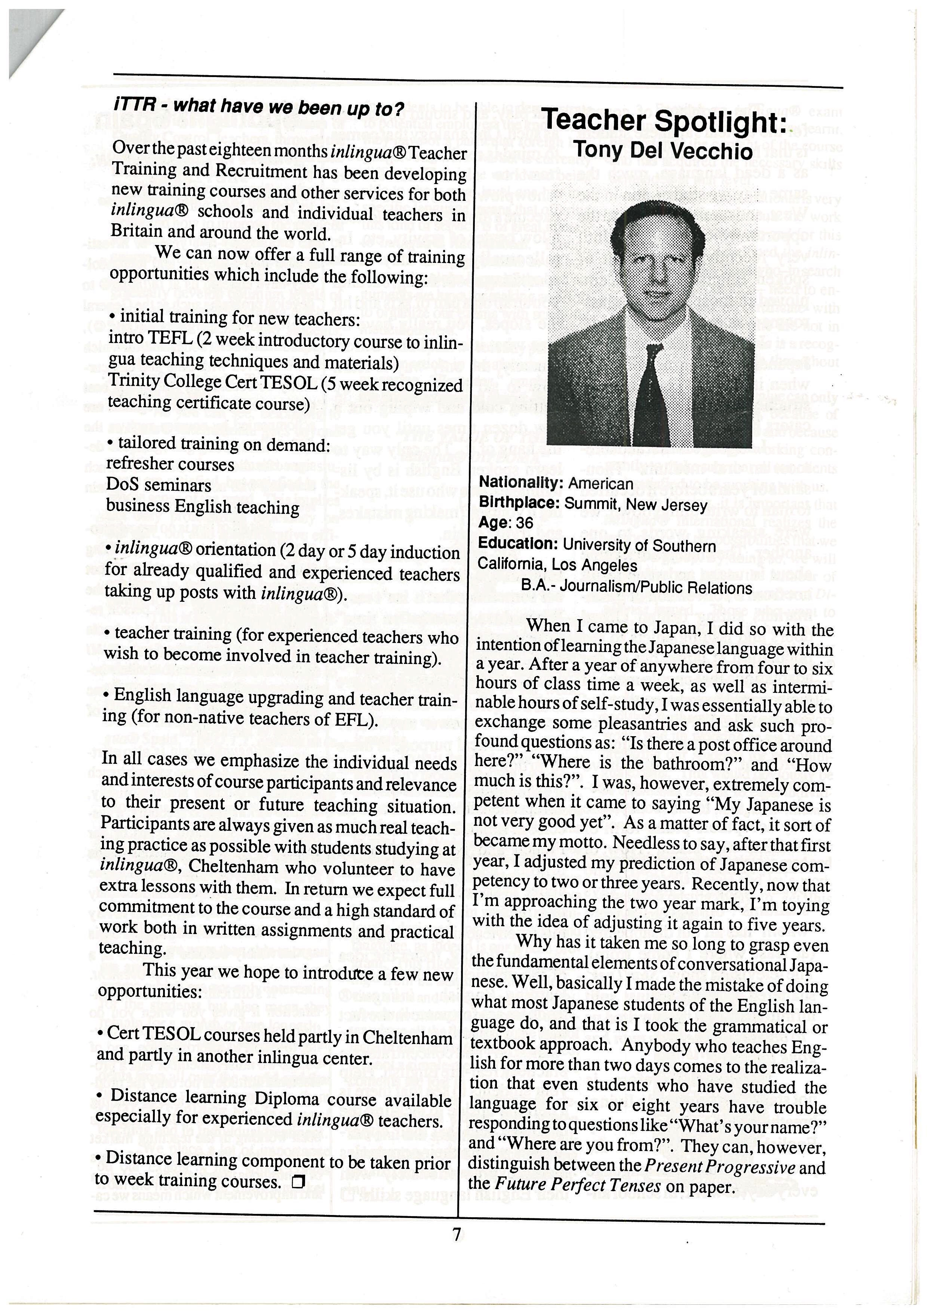
After about ten
years I got tired of
living in New Jersey
again and, hating
my job, moved to
Japan, getting
a job teaching
salarymen at a
Business English
school in Tokyo.

Slide 32
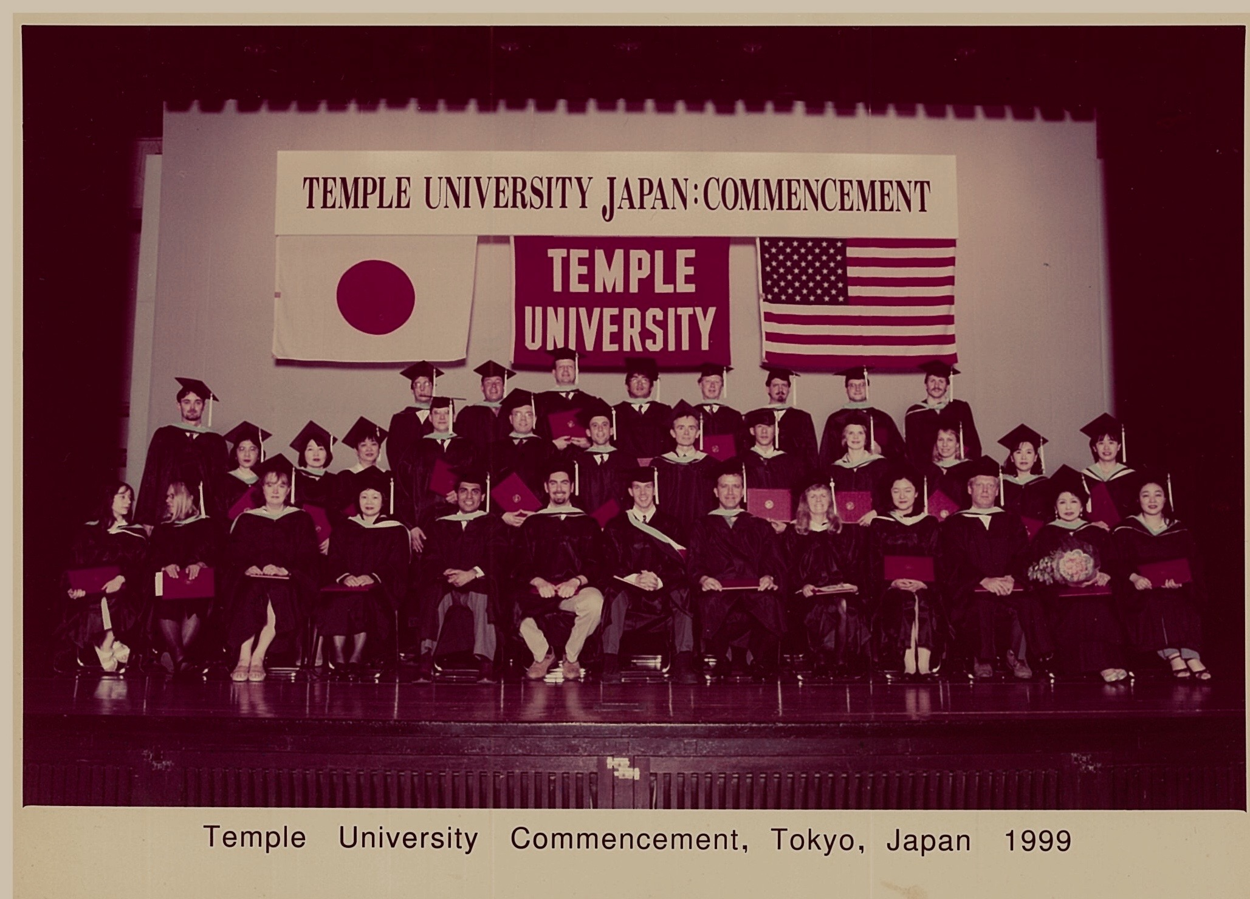
Went back to school at night 13 years after graduating college…

Slide 33
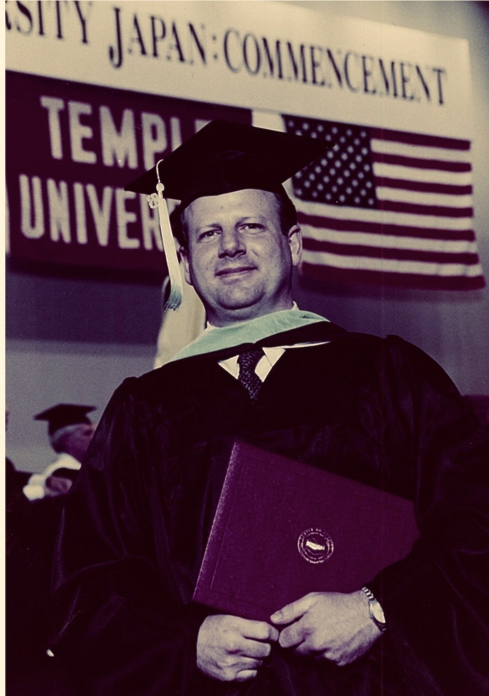
and got my Master’s
degree in Education in 1999.

Slide 34
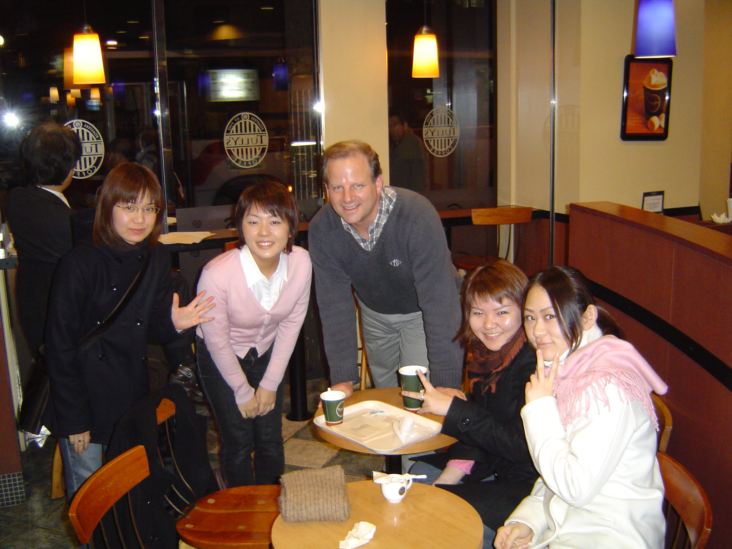
Started teaching in university.
(With some students at a Tully’s.)

Slide 35
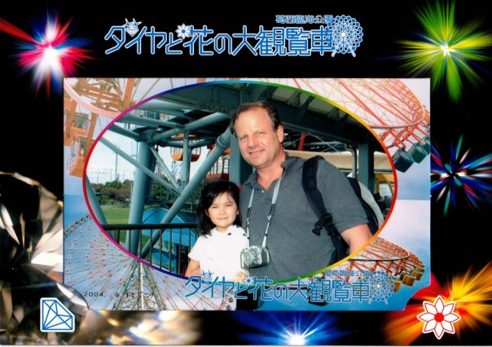
Got married and
had a daughter.
Got unmarried,
however. These
things happen.
But, Lili is always
in my heart.

Slide 36
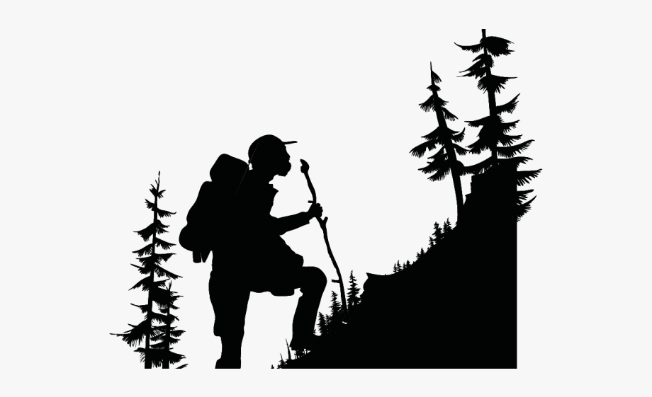
One of my hobbies is trekking.

Slide 37
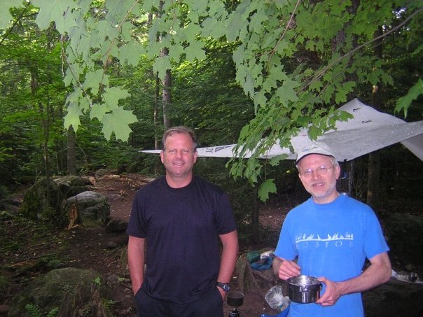
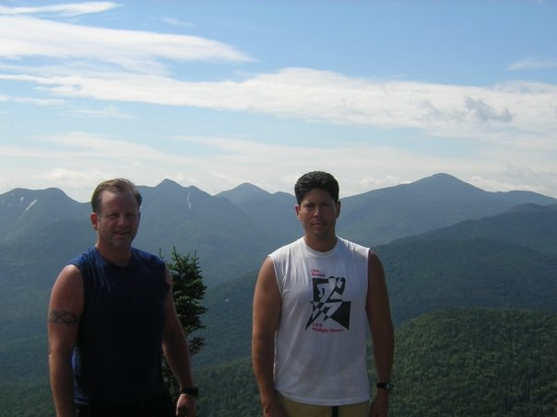
Here I am trekking in the Adirondacks in
Upstate New York with my homies Pete and Bob.

Slide 38
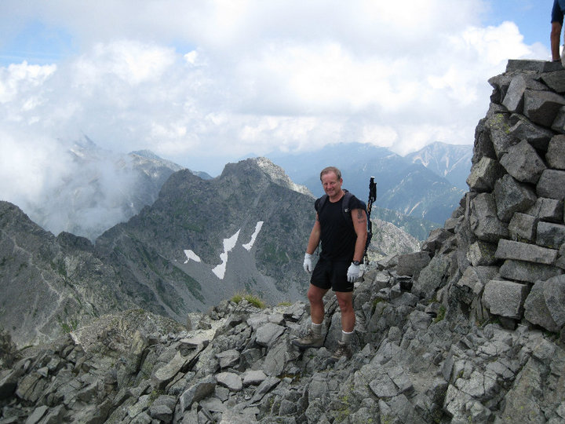
On top of Mount Okuhotaka-dake in the Kita Alps in 2007.
At 3,190 meters, “Okuho” is the third highest mountain in Japan.

Slide 39
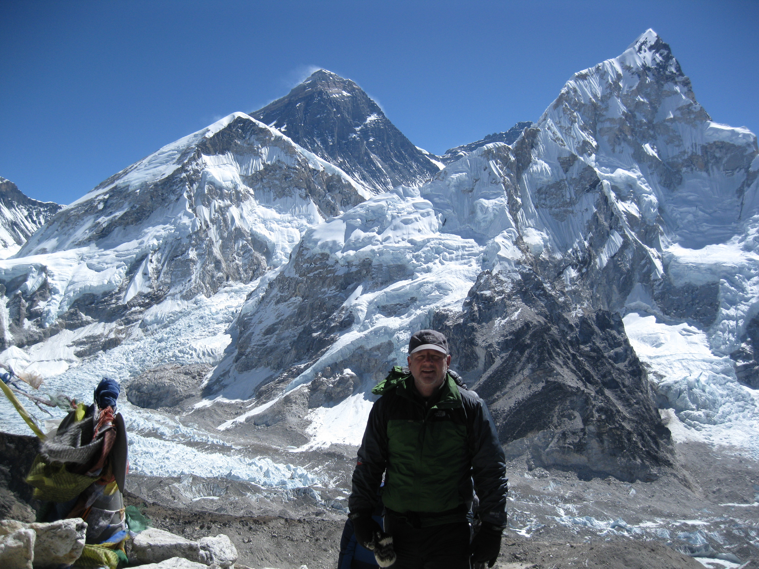
The literal high point of my life. Standing on top the
“hill” Kala Patthar (5,545 meters) in the Khumbu Region
of Nepal with Mount Everest in the background in 2012.

Slide 40
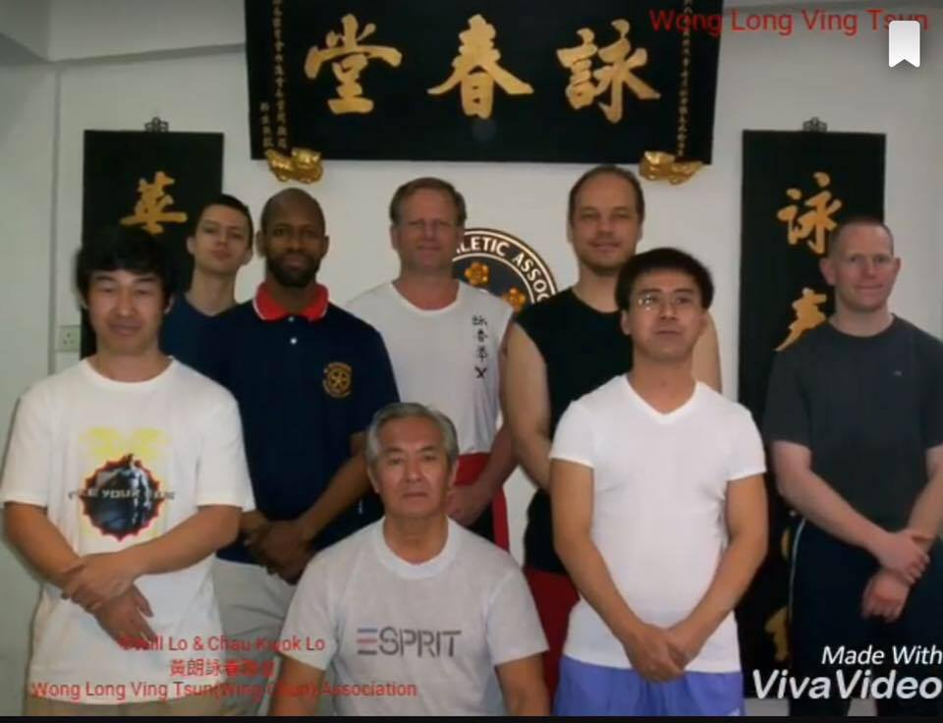
Another “hobby” of mine remains marital arts.
Here I am in Hong Kong in 2006 with my Wing Chun
Gung Fu Sifu (sensei), my classmates, and my Wing Chun
“great-grandfather” Wong Long Ching (Bruce Lee’s elder classamte)

Slide 41
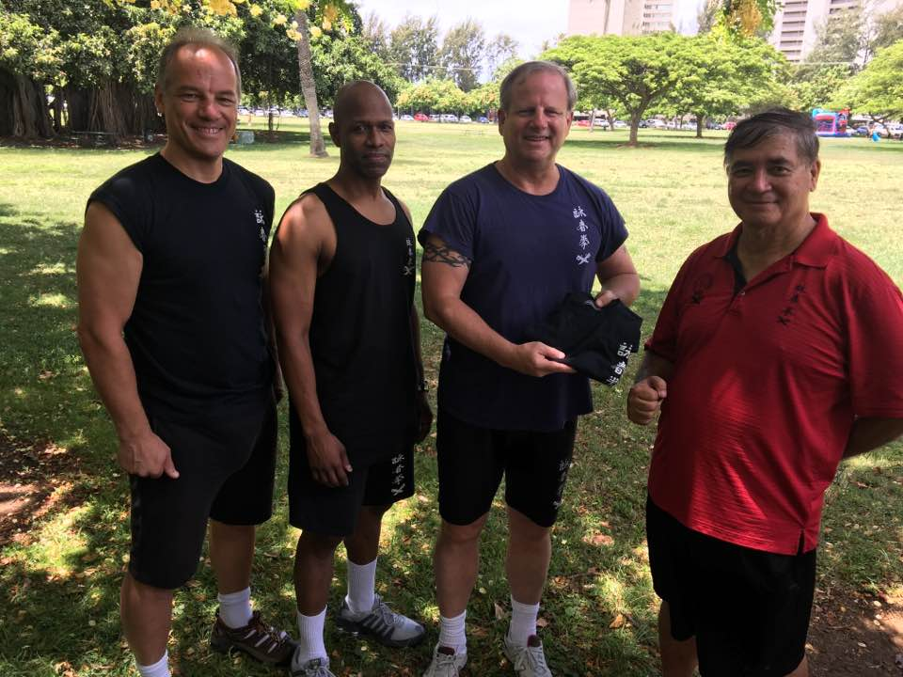
Getting my “Black Shirt” (Instructor I status) in Hawaii
with brother Malcolm Macnab, Sifu Embrey Williams,
and Grandmaster John DiVirgilio. August 2016

Slide 42
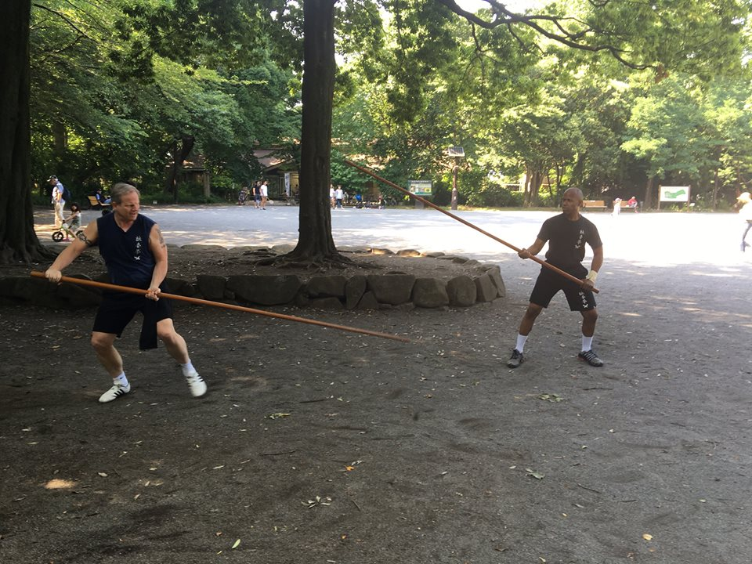
Practicing the Luk Dim Poon Kwan with Sifu in the park

Slide 43
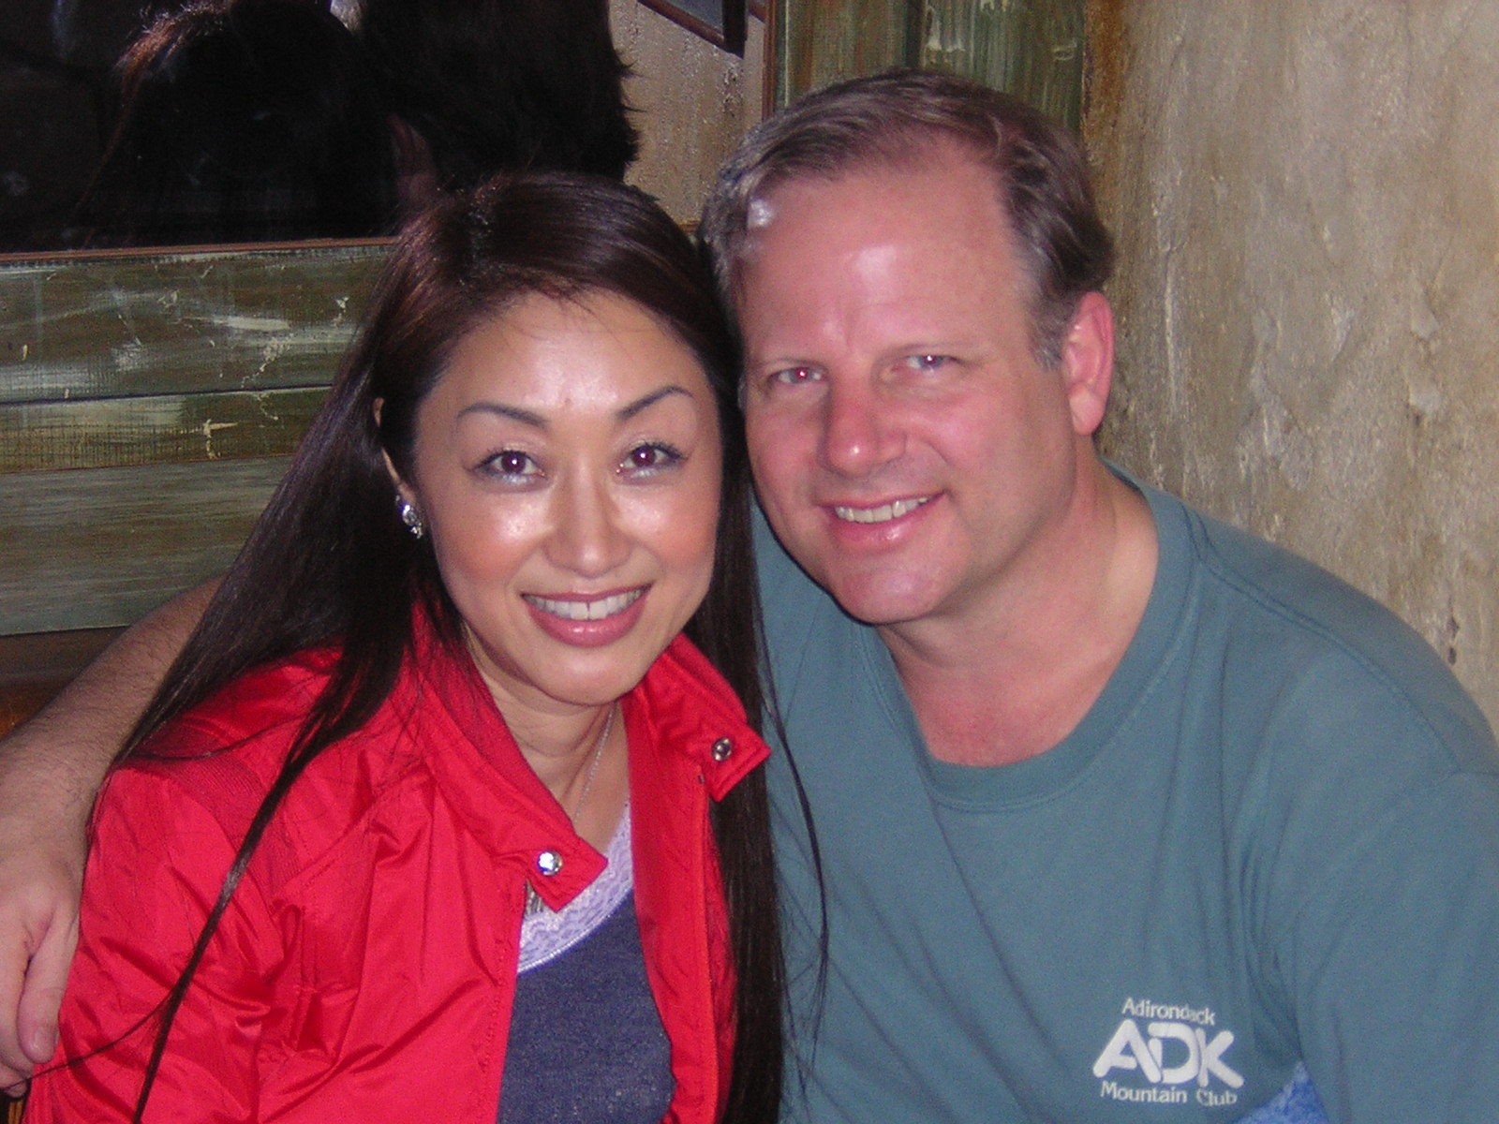
Oh yeah…and meanwhile I fell in love again…
(at Zest Restaurant 11/6/05)

Slide 44
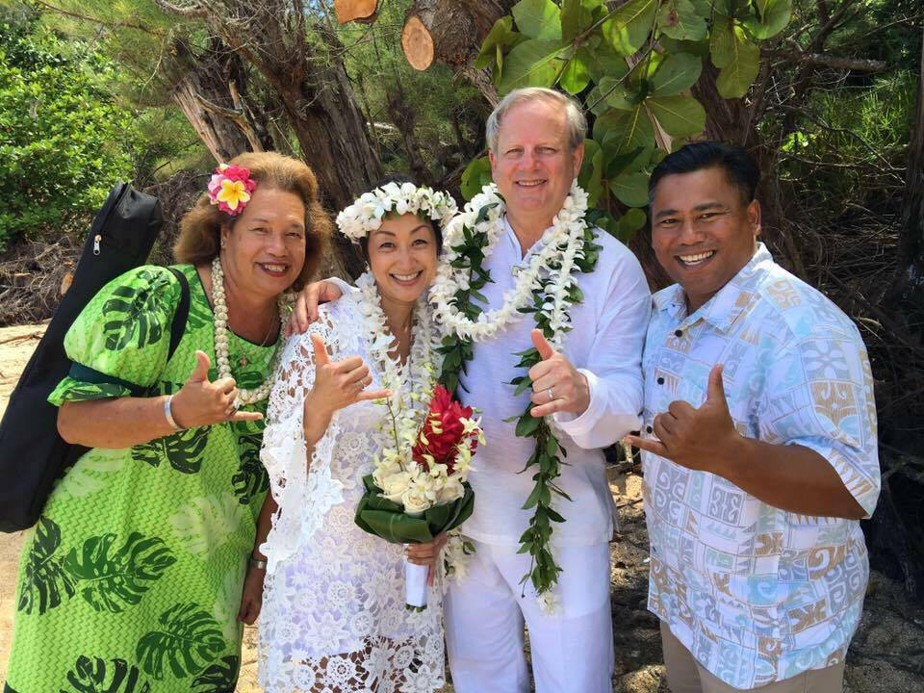
…and got married again.
(Wedding Day 8/30/16 - on Tunnels Beach, Kauai, Hawaii)

Slide 45
The story continues.

